Slide 1
Whatever is said is a Proposal (Do not assume it to be true or false)
Verify it on Your Own Right – on the basis of your Natural Acceptance
It is a process of Dialogue
A dialogue between me and you, to start with
It soon becomes a dialogue within your own self

Slide 2
The Role of Education
What is the Role of Education-The role of education is to facilitate the development of the competence to live with Definite Human Conduct*
*Conduct in accordance with one's Natural Acceptance

Slide 3
Out of the three types of fear, which is predominant for you?
Fear of Natural Calamities
Fear of Wild Animals
Fear of the Inhuman Behaviour of Human Being
Is this on the increase or decrease?
Literacy is increasing
The fear of the Inhuman Behaviour of Human Being is also increasing…

Slide 4
Basis of Definiteness of Conduct
All units around us exhibit definite conduct... except human being
Trees, Plants... Conduct is based on their seed
Cow.... Conduct is based on their breed
Human Beings Conduct is based on their education-sanskar

Slide 5
The Role of Education-Sanskar
What is the role of education-sanskar?
The role of education-sanskar is to facilitate the development of the competence to live with Definite Human Conduct
Is there need for such education-sanskar?
Who is responsible to make it available?
Parents, Teachers, Society
Are we able to ensure it?
If we want to provide such education-sanskar, what would be the basic requirements?
We will explore into this

Slide 6
Check within Yourself!
Is Human Relationship Important?
What do we all want?
Can we examine this within ourselves?

Slide 7
Desire
Do we want to be happy?
Do we want to be prosperous?
Do we want the continuity of happiness and prosperity?

Slide 8
Desire State of Being
Do we want to be happy?
Do we want to be prosperous?
Do we want the continuity of happiness and prosperity?
Are we happy?
Are we prosperous?
Is there continuity of our happiness and prosperity?

Slide 9
Desire Effort
Do we want to be happy?
Do we want to be prosperous?
Do we want the continuity of happiness and prosperity?
We will explore this further
Is our effort
For continuity of happiness and prosperity?
Just for accumulation of physical facility?
Have you assumed that happiness and prosperity will be ensured when you have enough physical facility?
What effort are you making for continuity of happiness and prosperity, other than accumulation of physical facility?

Slide 10
Check within Yourself!
The unhappiness in your family is
More due to lack of physical facility or
More due to lack of fulfillment in relationship?
How much time and effort are you investing:
For physical facility
For fulfillment in relationship
The unhappiness is more due to lack of fulfillment in relationship
Most of the time and effort is spent for physical facility

Slide 11
Check within Yourself!
For human beings physical facility is necessary but relationship is also necessary
On examining carefully, we find that this is a fundamental difference between animals and human beings
Physical facility is necessary for animals and necessary for human beings also
However, For animals physical facility is necessary as well as adequate
For human beings physical facility is necessary but not adequate

Slide 12
When an animal has lack of physical facility it becomes uncomfortable, when it gets physical facility it becomes comfortable
Eg. When a cow gets a stomach-full of grass, it becomes comfortable, sits and chews the cud
When a human being has lack of physical facility, he becomes uncomfortable and unhappy
But once he gets the physical facility, he forgets about it and starts thinking about hundred other things
(Check for yourself if you feel happy every day that you are getting enough to eat?)

Slide 13
For human beings, physical facility is necessary but relationship is also necessary
For animals, physical facility is necessary as well as adequate
For animals:
necessary & adequate
RELATIONSHIP
laca/k
with human beings
PHYSICAL FACILITY
lqfo/kk
With nature
i’kq ds fy,
vko’;d
,oa iw.kZ
For human beings:
necessary but
not adequate
ekuo ds fy,
vko’;d
ijarq iw.kZ ugha

Slide 14
Other than physical facility what else does a human being think about?
On close examination, the list of thoughts can be classified into two categories:
Feelings in relationship with other human beings
Right understanding in the self, or knowledge
Human beings think about ensuring these, in addition to physical facility

Slide 15
If we recognize human beings’ aspiration, we find that they want to live in relationship with all and feel happy living in relationship, therefore relationship is necessary for human beings
Examine within yourself if
You want to live in relationship (harmony) with others or
You want to live in opposition with others or
You believe living has to be necessarily in opposition with others, ie. There is 'struggle for survival' , ‘survival of the fittest’ and check if you feel happy living this way?
Thus: for human beings, both physical facility and relationship are necessary

Slide 16
For Human Being, both Physical Facility and Relationship are Necessary
For animals:
necessary & adequate
RELATIONSHIP
with human beings
PHYSICAL FACILITY
With nature
For human beings:
necessary but
not adequate

Slide 17
On further examination, we find that we all do want to live in relationship with others
Every night when there is a fight, we want to resolve it. We start the next day with the thought that we don’t want to fight today, but due to lack of right understanding about fulfillment of relationship, a fight takes place by night
For fulfillment in relationship, it is necessary to have right understanding about relationship. i.e. Right understanding is also necessary for human beings

Slide 18
Right Understanding is also Necessary for Human Being
RIGHT UNDERSTANDING
in the self
RELATIONSHIP with human beings
PHYSICAL FACILITY
with rest of nature
For animals: necessary & adequate
For human beings:
necessary but
not adequate
Are all 3 required? Is something redundant? Is anything more required?
Are we working on all 3?
If all 3 are required, what would be the priority*?
*Working on the high priority makes it easier to deal with the lower priority

Slide 19
Priority: Right Understanding, Relationship & Physical Facility
1
RIGHT UNDERSTANDING
in the self
2
3
For animals: necessary & adequate
RELATIONSHIP with human beings
PHYSICAL FACILITY
with rest of nature
Feelings
- Trust
- Respect
- …
For human beings:
necessary but
not adequate
MUTUAL HAPPINESS
MUTUAL PROSPERITY

Slide 20
Priority: Physical Facility
?
RIGHT UNDERSTANDING
in the self
?
1
For animals: necessary & adequate
RELATIONSHIP with human beings
PHYSICAL FACILITY
with rest of nature
For human beings:
necessary but
not adequate
UNHAPPINESS
Making others Unhappy
DEPRIVATION
Exploiting and
Depriving others

Slide 21
I desire for happiness
If I am not aware that right feelings (trust respect … love) in me is a source of happiness for me
Expressing these feelings to the other can be a source of happiness for the other
Leading to mutual happiness
Then
I have only option, i.e. to draw happiness from physical facility (includes sensation) even though it is not continuous (tasty & necessary… intolerable)
Once I become aware that right feelings (trust respect … love) in me is a source of happiness for me, I start paying attention to it
Then
My dependence on physical facility (including sensation) reduces

Slide 22
While I do not want to fight, a fight takes place…
I try to resolve it by giving a gift (tasty food, nice clothes etc.). Sometimes this works… Now I can see that it only shifts the attention from the fight to the gift, and only for a short time… In a few days, another fight takes place, and this time it is of greater intensity… Now I can see that it is due to lack of right understanding about relationship
I have been trying to fill this gap by more and more sensation
The happiness I draw out of physical facility (including sensation) is not long lasting; I get bored by one sensation… so I go for another
The happiness I get from feelings is long lasting, continuous. My need for getting these feelings from the other is also continuous
Right feelings (trust respect … love) in me is a source of happiness for me

Slide 23
With insufficient understanding and insufficient fulfilment in relationship, when we put in effort only for physical facility
Firstly, we do not experience happiness
Secondly, without right understanding, we are never able to rightly determine our requirement of physical facility
Therefore, in-spite of having accumulation of physical facility, we feel that we do not have sufficient physical facility and we continually have the feeling of deprivation

Slide 24
Therefore we can observe two categories of human beings
Lacking physical facility, unhappy deprived (Having physical facility, unhappy deprived
While we want to be –Having physical facility, happy prosperous
Check within yourself
Where are you now – at 1, 2 or 3 and
Where do you want to be?
If our living is only for physical facility, then we are living with animal consciousness, because animals live only for physical facility and are fulfilled by that, not human beings

Slide 25
Animal Consciousness, Indefinite Conduct
?
RIGHT UNDERSTANDING
in the self
?
1
RELATIONSHIP with human beings
PHYSICAL FACILITY
with rest of nature
Animal Consciousness
UNHAPPINESS
Making others Unhappy
DEPRIVATION
Exploiting and
Depriving others

Slide 26
If we are living for all three (right understanding, relationship and physical facility) then we are living with human consciousness
Human beings can be fulfilled by being happy and prosperous on the basis of these three

Slide 27
Human Consciousness, Definite Human Conduct
Human Consciousness
RIGHT UNDERSTANDING
in the self
1
2
RELATIONSHIP with human beings
PHYSICAL FACILITY
with rest of nature
3
Feelings
- Trust
- Respect
- …
MUTUAL HAPPINESS
MUTUAL PROSPERITY

Slide 28
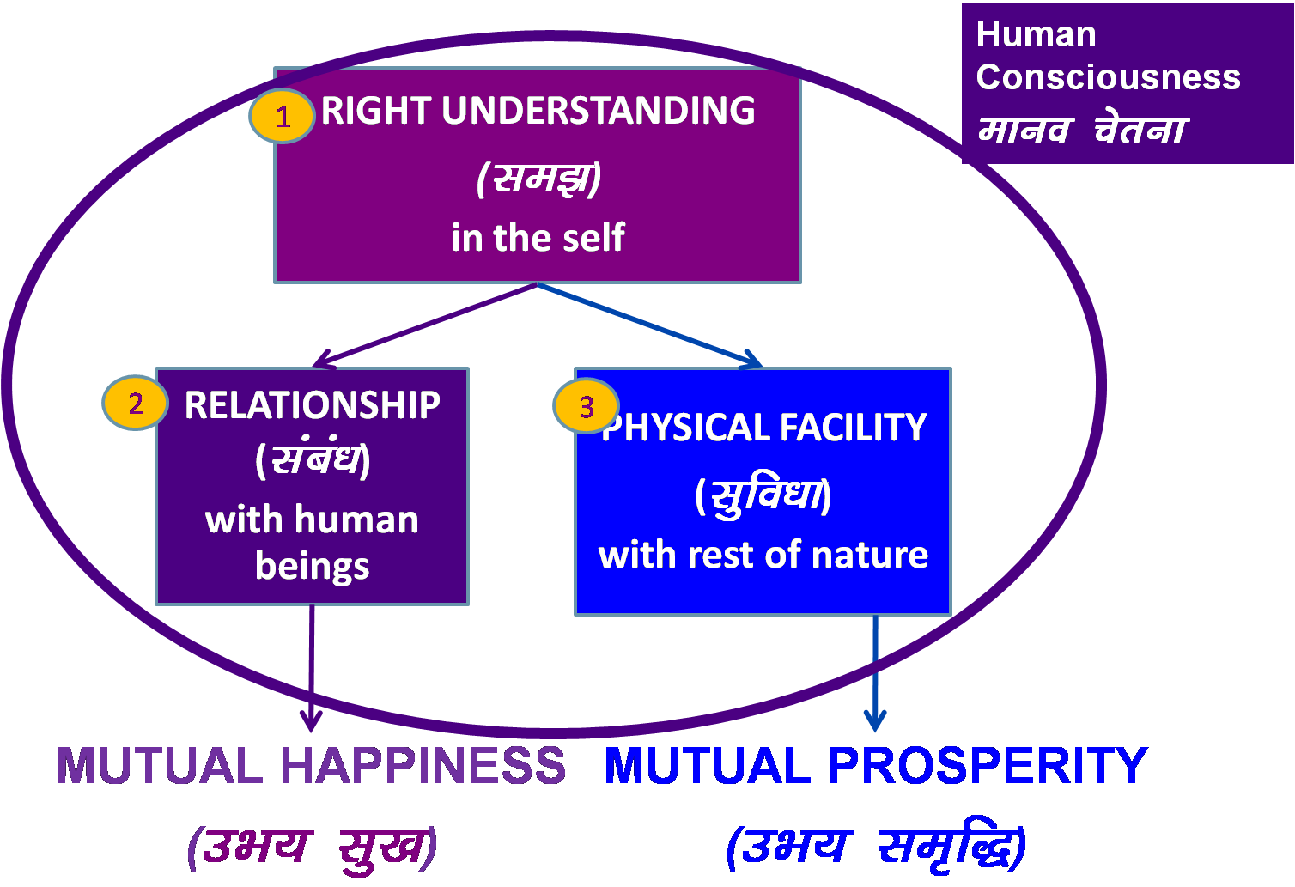
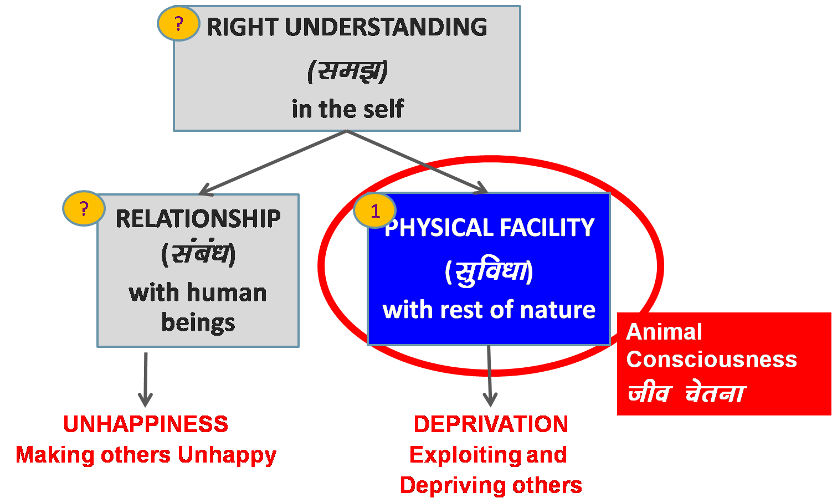
Transformation (ladze.k) = Development (fodkl)
Transformation& Progress

Slide 29
Transformation (ladze.k) = Development (fodkl)
Human Consciousness
1
RIGHT UNDERSTANDING
in the self
Transformation& Progress
2
RELATIONSHIP with human beings
3
PHYSICAL FACILITY
with rest of nature
Animal Consciousness
MUTUAL HAPPINESS
MUTUAL PROSPERITY

Slide 30
Role of Education-Sanskar: Enable Transformation
The role of education is to facilitate the development of the competence to live with Definite Human Conduct
Transformation& Progress

Slide 31
Role of Education-Sanskar: Enable Transformation
Human Consciousness
1
RIGHT UNDERSTANDING
in the self
Transformation& Progress
2
RELATIONSHIP
with human beings
3
PHYSICAL FACILITY
with rest of nature
Animal Consciousness
MUTUAL HAPPINESS
MUTUAL PROSPERITY

Slide 32
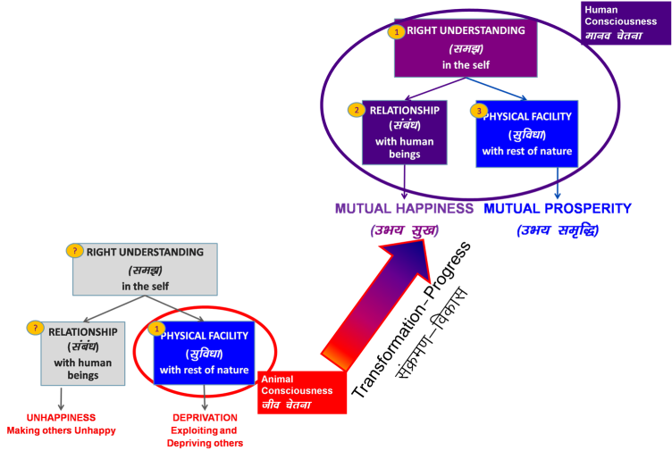
Role of Education-Sanskar: To Enable Transformation
Holistic development is transformation to Human Consciousness.
The role of education-sanskar is to enable this transformation by way of ensuring the development of the competence to live with Definite Human Conduct
For this, the education-sanskar has to ensure
Right understanding in the self of every child
The capacity to live in relationship with the other human beings
The capacity to identify the need of physical facility and the skills & practice for sustainable production of more than what is required leading to the feeling of prosperity
These are the 3 components of human eduction-sanskar, if it has to ensure development of definite human conduct

Slide 33
Role of Education-Sanskar: Enable Transformation
Holistic development is transformation to Human Consciousness.
The role of education-sanskar is to enable this transformation by way of ensuring the development of the competence to live with Definite Human Conduct
For this, the education-sanskar has to ensure
Right understanding in the self of every child
The capacity to live in relationship with the other human beings
The capacity to identify the need of physical facility and the skills & practice for sustainable production of more than what is required leading to the feeling of prosperity
These are the 3 components of human eduction-sanskar, if it has to ensure development of definite human conduct
If we look at the education we are giving today…
First one is missing
The second one is missing
In the third one, identification of physical facility, is also missing. The willingness to produce by way of labour is also missing. The core feeling that is generated is to accumulate more & more rather than produce more & more ; and to consume more & more

Slide 34
Role of Education-Sanskar: Enable Transformation
The role of education-sanskar is to facilitate the development of the competence to live with Definite Human Conduct by ensuring all 3 (Right Understanding, Relationship and Physical Facility) – in every Human Being
Parents, teachers & society/environment have the responsibility of providing such education-sanskar
Education – Developing Right Understanding (WHAT TO DO)
Sanskar – Commitment/ Preparation/ Practice for Right Living
. Preparation includes Learning Right Skills & Technology
(HOW TO DO)

Slide 35
Course/Workshop Content: Right Understanding
RIGHT UNDERSTANDING
in the self
Understanding Harmony:
Harmony in the Individual
Harmony in Family
Harmony in Society
Harmony in Nature/Existence
1
2
RELATIONSHIP with human beings
PHYSICAL FACILITY
with rest of nature
Living in Harmony at
all 4 levels:
Individual
Family
Society
Nature/Existence
3
Feelings
- Trust
- Respect
- …
MUTUAL HAPPINESS
MUTUAL PROSPERITY

Slide 36
Right Understanding
Human Consciousness
RIGHT UNDERSTANDING
in the Self
– Understanding Harmony in Individual, Family, Society, Nature/Existence
1
2
JUSTICE in RELATIONSHIP
with Human Being
- from Family to World Family
3
PARTICIPATION in LARGER ORDER
with Nature
- From Family Order to World Family Order
MUTUAL HAPPINESS
UNDIVIDED SOCIETY
FULFILMENT of HUMAN GOAL
UNIVERSAL HUMAN ORDER

Slide 37
Course/Workshop Methodology: Self Exploration
Whatever is said is a Proposal (Do not assume it to be true or false)
Verify it on Your Own Right – on the basis of your Natural Acceptance
It is a process of Dialogue
A dialogue between me and you, to start with
It soon becomes a dialogue within your own self

Slide 38
Sum Up: Holistic Development & The Role of Education
The role of education-sanskar is to enable the transformation to Human Consciousness (i.e. holistic development) by way of ensuring the development of the competence to live with Definite Human Conduct
For this, the education-sanskar has to ensure
Right understanding in the self of every child
The capacity to live in relationship with the other human beings
The capacity to identify the need of physical facility and the skills & practice for sustainable production of more than what is required leading to the feeling of prosperity
These are the 3 components of human education-sanskar, if it has to ensure development of definite human conduct
Parents, teachers & society/environment have the
responsibility of providing such
education-sanskar
We will explore the steps necessary to ensure
Human Education-Sanskar

Slide 39
Role of Education-Sanskar: Enable Transformation
The role of education is to facilitate the development of the competence to live with Definite Human Conduct
Transformation& Progress

Slide 40
Role of Education-Sanskar: Enable Transformation
Human Consciousness
1
RIGHT UNDERSTANDING
in the self
Transformation& Progress
2
RELATIONSHIP
with human beings
3
PHYSICAL FACILITY
with rest of nature
Animal Consciousness
MUTUAL HAPPINESS
MUTUAL PROSPERITY

Slide 41
Guidelines for Value Education
Universal
Whatever is studied as value education needs to be universally applicable to all human beings and be true at all times and all places.
It should not depend on sect, creed, nationality, race, gender, etc.
Rational
It has to be amenable to logical reasoning.
It should not be based on blind beliefs.
Verifiable
The student should be able to verify the values by checking with one's own experience, and is not asked to believe just because it is stated in the course.
Leading to Harmony
Values have to enable us to live in peace and harmony within our own self as well as with others (human being and rest of nature).

Slide 42
Content of Value Education (All Encompassing)
Human Consciousness
RIGHT UNDERSTANDING
in the Self
– Understanding Harmony in Individual, Family, Society, Nature/Existence
1
2
JUSTICE in RELATIONSHIP
with Human Being
- from Family to World Family
3
PARTICIPATION in LARGER ORDER
with Nature
- From Family Order to World Family Order
MUTUAL HAPPINESS
UNDIVIDED SOCIETY
FULFILMENT of HUMAN GOAL
UNIVERSAL HUMAN ORDER

Slide 43
Process of Value Education (Self-verification)
Whatever is said is a Proposal (Do not accept it to be true or false)
Verify it on your own right
Proposal
1
2
Verify
on the basis
Of
your
Natural
Acceptance
Experiential Validation
Live according to it
2a
2b
Behaviour with
Human Beings
Work with
Rest of Nature
Mutual Happiness
Mutual Prosperity
Right
Understanding

Slide 44

Basic Human Aspiration – Happiness, Prosperity 🡪 Continuity
Happiness
To be in a state of Harmony is Happiness
– Harmony at all levels of my being – from self to entire existence
Prosperity
The feeling of having more than required Physical Facility
– Physical Facility is required only for nurturing, protection & right utilisation of the Body

Slide 45
Happiness Unhappiness
The state or situation, in which I live,
if there is harmony / synergy in it,
then it is Naturally Acceptable to me to be in that state / situation
To be in a state / situation which is Naturally Acceptable is Happiness
To be in in a state of Harmony / Synergy is Happiness
Happiness = Harmony
The state or situation, in which I live,
if there is disharmony / contradiction in it,
then it is not Naturally Acceptable to me to be in that state / situation
To be forced to be in a state / situation which is not Naturally Acceptable is Unhappiness
To be forced to be in a state of Disharmony / Contradiction is Unhappiness
Unhappiness = Disharmony

Slide 46
Happiness Continuity of Happiness
The state or situation, in which I live,
if there is harmony / synergy in it,
then it is Naturally Acceptable to me to be in that state / situation
To be in a state / situation which is Naturally Acceptable is Happiness
To be in a state of Harmony / Synergy is Happiness
Happiness = Harmony
State / Situation in which I live or Expanse of my Being:
As an Individual
As a member of a Family
As a member of Society
As an unit in Nature/Existence
Continuity of Happiness = Harmony at all levels of my Being. i.e.
Harmony in the Human Being
Harmony in the Family
Harmony in the Society
Harmony in Nature/Existence

Slide 47
Scope of Right Understanding in the Self
1
Right Understanding i.e. Understanding the reality, as it is
Understanding the Human Being (Individual) – Harmony in the Human Being
Understanding Human-Human Relationship – Harmony in the Family
Understanding Society – Harmony in the Society
Understanding Human-Nature/Existence Relationship – Harmony in Nature/Existence
Desirability: Right Understanding – in every human being

Slide 48
Scope of Relationship with Human Being
2
Right Feelings in Relationship:
Understanding these feelings, ensuring continuity of these feeling in the self leads to happiness. Expressing these feelings to the other leads to his/her happiness, i.e. mutual happiness
Justice = Recognition, Fulfillment & Evaluation of Human-Human Relationship, leading to Mutual Happiness
Desirability: Right Feelings – in every human being & sharing right feelings
i.e. Justice – from Family to World Family 🡪 Undivided Society
1- Trust FOUNDATION VALUE
2- Respect
3- Affection
4- Care
5- Guidance
6- Reverence
7- Glory
8- Gratitude
9- Love COMPLETE VALUE

Slide 49
Scope of Human Order
3
Human Goal
Five Dimensions of Human Order
1. Education–Sanskar
2. Health–Sanyam
3. Production–Work
4. Justice–Suraksha
5. Exchange–Storage
Desirability: Fulfillment of Human Goal for all human beings
i.e. Family Order to World Family Order 🡪 Universal Human Order
Qs: Is there a provision in Nature for living thus? Is existence in chaos?
Right Understanding & Right Feelings
Prosperity
Fearlessness
(Trust)
Co-Existence
In Every Individual
In Every Family
In Society
In Nature/ Existence

Slide 50
Current State – Have we understood our Goal?
Human Target
Gross Misunderstanding
Right Understanding & Right Feelings
Prosperity
Fearlessness
(Trust)
Co-Existence
In Every Individual
In Every Family
In Society
In Nature/ Existence
Assumptions (eg. Money is everything)
Accumulation
By Any Means
Domination ,
Exploitation, Fear
Mastery &
Exploitation
In Every Individual
In few Individuals
In Society
Over Nature
Madness for Consumption Hkksx mUekn
Madness for Profit ykHk mUekn
Madness for Sensual Pleasure dke mUekn
Terrorism
War
Resource Depletion
Pollution

Slide 51

FAO Report – 11-May-2011
Of the 4.2 billion tons of food produced, more than 1 billion tons of food is lost or wasted every year, UN-backed report finds (11 May 2011)
About a third of all the food produced for human consumption each year – or roughly 1.3 billion tons – is lost or wasted, according to a new study commissioned by the United Nations Food and Agriculture Organization (FAO)
Global Food Production is 6 times requirement
Global Food Wastage is 1/3rd of production
Wastage is enough to feed 1300 crore people/year
Have we understood right utilisation?
Is it a question of production?
Is it a question of distribution?
Is it a question of relationship?
Is it a question of right understanding?
It is a question of right education-sanskar
http://www.un.org/apps/news/story.asp?NewsID=38344&Cr=fao&Cr1

Slide 52
State of Education-sanskar 🡨🡪 State of Society
Education-sanskar shapes the society of the future
If we are providing human education-sanskar, students will exhibit definite, human conduct & they will contribute toward a humane society in future
If we are not providing such education-sanskar, students will exhibit indefinite, inhuman conduct & they will contribute to an inhumane society in future
The state of society today indicates that:
There is increasing tension in individuals, division in family, terrorism in society…
There is increasing exploitation of nature, climate change, global warming…
Is it desirable to ensure human education-sanskar?
Are we ensuring human education-sanskar?

Slide 53
51A. Fundamental Duties
51A. Fundamental duties.—It shall be the duty of every citizen of India—
(a) to abide by the Constitution and respect its ideals and institutions, the National Flag and the National Anthem;
(b) to cherish and follow the noble ideals which inspired our national struggle for freedom;
(c) to uphold and protect the sovereignty, unity and integrity of India;
(d) to defend the country and render national service when called upon to do so;
(e) to promote harmony and the spirit of common brotherhood amongst all the people of India transcending religious, linguistic and regional or sectional diversities; to renounce practices derogatory to the dignity of women;
(f) to value and preserve the rich heritage of our composite culture;
(g) to protect and improve the natural environment including forests, lakes, rivers and wild life, and to have compassion for living creatures;
(h) to develop the scientific temper, humanism and the spirit of inquiry and reform;
(i) to safeguard public property and to abjure violence;
(j) to strive towards excellence in all spheres of individual and collective activity so that the nation constantly rises to higher levels of endeavour and achievement.

Slide 54
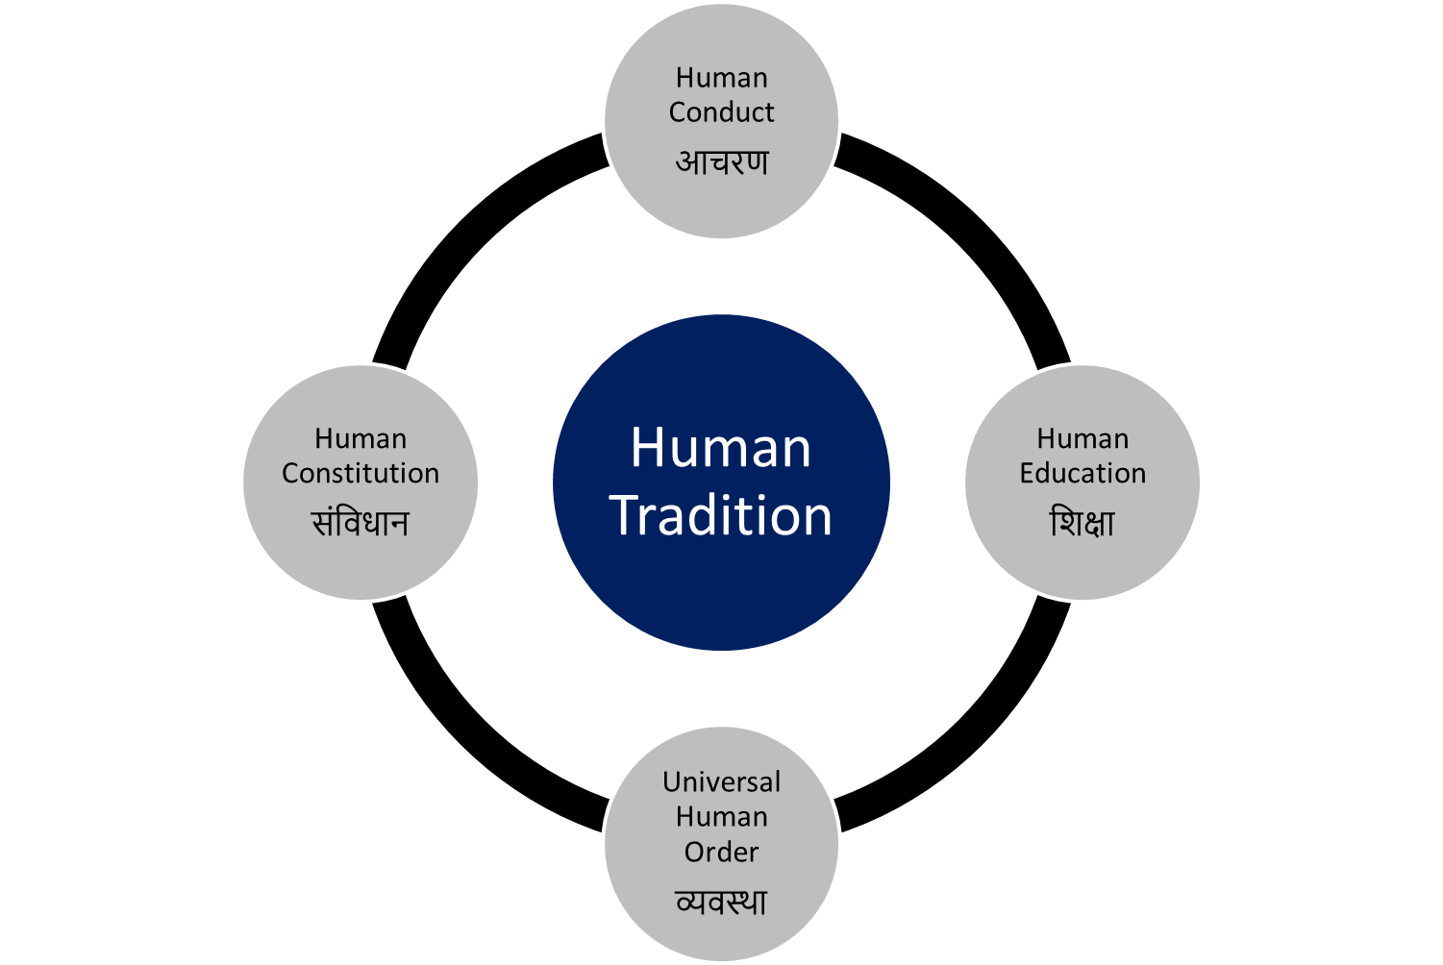
Universal Human Order: Dynamics
Conduct that ensures
continuity of mutual
happiness &
prosperity
Education that
ensures the
development of the
competence to live
with
Definite
Human
Conduct
Nature of
society
of people living
together in a
relationship of
mutual fulfillment
Entry Point
The society in which
Human Goal
is realised

Slide 55
Sum Up: Holistic Development & The Role of Education
The role of education-sanskar is to enable the transformation to Human Consciousness (i.e. holistic development) by way of ensuring the development of the competence to live with Definite Human Conduct
For this, the education-sanskar has to ensure
Right understanding in the self of every child
The capacity to live in relationship with the other human beings
The capacity to identify the need of physical facility and the skills & practice for sustainable production of more than what is required, leading to the feeling of prosperity
These are the 3 components of human education-sanskar, if it has to ensure development of definite human conduct
Parents, teachers & society/environment have the
responsibility of providing such
education-sanskar
We will explore the steps necessary to ensure
Human Education-Sanskar

Slide 56
Home Work
What is naturally acceptable to you
to live with animal consciousness or
to live with human consciousness?
Are you living in animal consciousness or human consciousness?
Is this transformation from animal consciousness to human consciousness desirable?
What is the role of education in this transformation?

